Slide 1

Project 2 – Jobs Analysis
Adzure

Slide 2
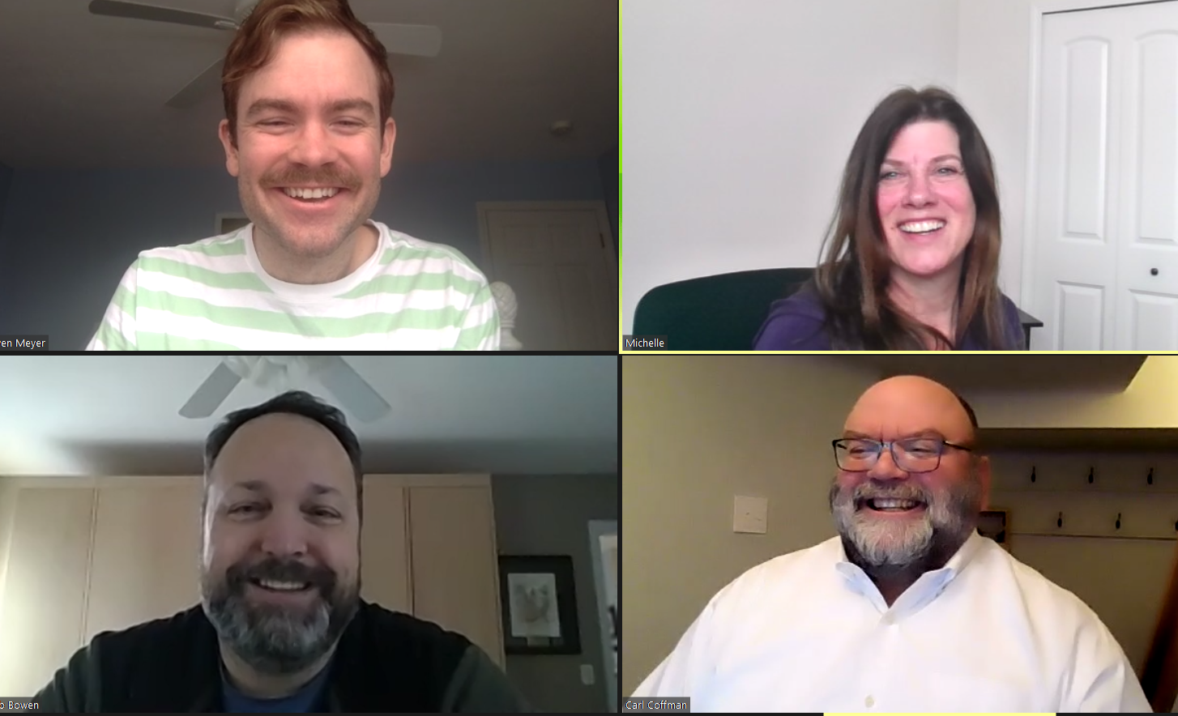
Meet the dream team!
Owen Meyer
Michelle Bannon
Rob Bowen
Carl Coffman

Slide 3
Project Challenges
Getting data
Getting data:
API’s required a paid subscription
Indeed (restricted number of pages)
LinkedIn
Glass Door
Parshub
Decided on an API’s for Adzula salary was generally null
Running out of our API data
Getting good data from the API; Less than 5% had salary

Slide 4

Project challenges Continued
GIT HUB SAYS YOUR CHANGES ARE REJECTED!

Slide 5
Provide users an interactive means to explore data
Add screen shots of main screen and search capability
Your project must include some level of user-driven interaction (e.g., menus, dropdowns, textboxes).

Slide 6
Use flask Python to pull data
Add screen shot
Python Flask–powered API, HTML/CSS, JavaScript, and at least one database (SQL, MongoDB, SQLite, etc.).
A combination of web scraping and Leaflet or Plotly
Your project must be powered by a data set with at least 100 records.

Slide 7
A dashboard page with multiple charts that update from the same data
Add screen shot
one JS library that we did not cover.

Slide 8
Use flask Python to pull data
Add screen shot
Python Flask–powered API, HTML/CSS, JavaScript, and at least one database (SQL, MongoDB, SQLite, etc.).

Slide 9


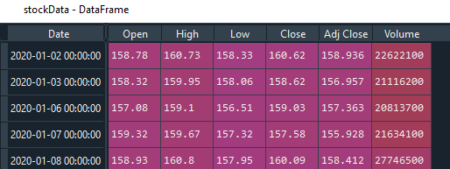
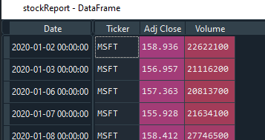
Sample Data
Import Daily Stock Price
yfinance - # Yahoo! Finance market data
https://github.com/ranaroussi/yfinance
Install yfinance using pip:
$ pip install yfinance --upgrade --no-cache-dir
Requirements
Python >= 2.7, 3.4+
Pandas >=0.23.1
Raw data
Required Fields
Each stock’s CSV data merged with complete CSV dataset

Slide 10
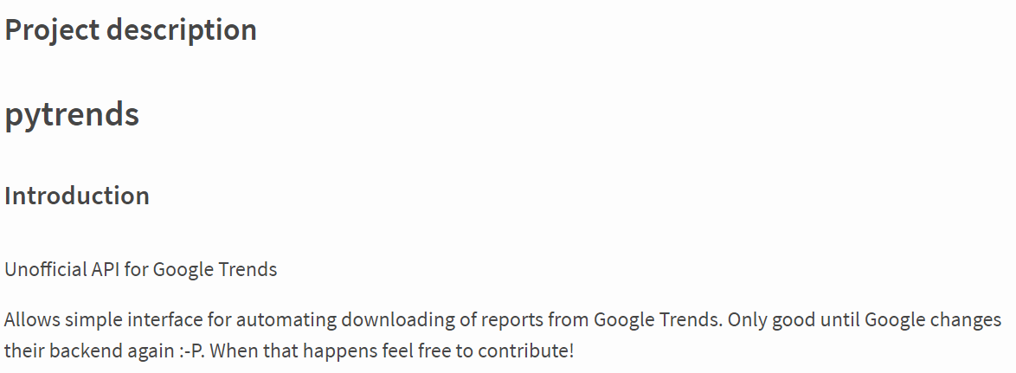
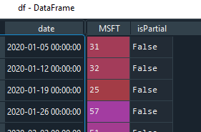
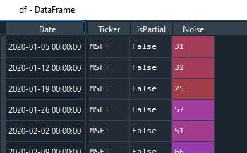
Trend Data
Import Daily Trend of key word (stock/ticker)
Raw data
pytrends - Unofficial API for Google Trends $pip install pytrends
- Interface for automating downloads of reports from Google Trends
Required Fields
Each stock’s CSV data merged with complete CSV dataset

Slide 11
BACKUP SLIDES
Backup

Slide 12
Project Description
Tell a story with data visualization
Focus on providing users an interactive means to explore data themselves. If daily source can’t be found, warehouse daily to build missing data
Prepare a 5-minute presentation that lays out your theme, coding approach, data munging techniques, and final visualization.
You may choose a project of any theme, but we encourage you to think broadly.
You will have ample time in class to work with your group, but expect to put in hours outside of class as well.

Slide 13
Project Requirements
Your visualization must include a Python Flask–powered API, HTML/CSS, JavaScript, and at least one database (SQL, MongoDB, SQLite, etc.).
Your project should fall into one of the below four tracks:
A custom “creative” D3.js project (i.e., a nonstandard graph or chart)
A combination of web scraping and Leaflet or Plotly
A dashboard page with multiple charts that update from the same data
A “thick” server that performs multiple manipulations on data in a database prior to visualization (must be approved)
Your project should include at least one JS library that we did not cover.
Your project must be powered by a data set with at least 100 records.
Your project must include some level of user-driven interaction (e.g., menus, dropdowns, textboxes).
Your final visualization should ideally include at least three views.

Slide 14
Notes from Owen
// To run, type 'flask run' in the terminal. Ctrl + click on url to open page
var data = JSON.parse(d3.select('#dataScript').attr('indata'));
// the program starts with the flask app;this is what we are doing in app.py "myclient" indicates where the client lives
// indeedDB is the database
// @app.route runs the function for the url
// checks the query, gets results, puts the results to the db, then pulls the results; once it has the result varibalbes it's going to put it in the render_template
// reload page go to the page
// grab parameters from text boxes
// searchs those parameters; query with those parameters (this returns the jobs)
// gets jobs from the query
// jobs to DB, jobs from database
// now we have the jobs from the db
// next flask will render the html at your localhost (lets you enter textbox params and data)
// file.js (this is the michelle.js)
// select html tag with the data that is the d3.select('#dataScript')
// next you get the tag .attr('indata)
// make data json type by the [JSON.parse()]
// d3.select(#michelle), this will call div id which is where I will put the graph inside it.
// map in d
// use Javascript to create the graphs var michllesTag = d3.select('#michelle')
// make visual with data
// append visual to div go into d3 challeng ; javascript file in the d3 challenge

